Slide 1
Applicant Details for Loan Approval
Muhammad Afif Bin Adeni

Slide 2
Problem Statement
Financial institutions, such as banks, face the challenge of efficiently and accurately assessing the creditworthiness of loan applicants.
A cumbersome and lengthy loan approval process affect customer experience, leading to frustration and potential loss of business for banks.
Organizations with slow approval systems risk losing customers to competitors offering faster services, leading to reduced market share and revenue.

Slide 3
Approach
Data collected from Kaggle.com.
This data included information about applicants such as their income, age, work experience, and other relevant factors.
Data gathered on past loan defaults to understand patterns and trends.
Two Machine Learning Models (Random Forest and Logistic Regression) used to demonstrate the best performance in predicting loan default risk.

Slide 4
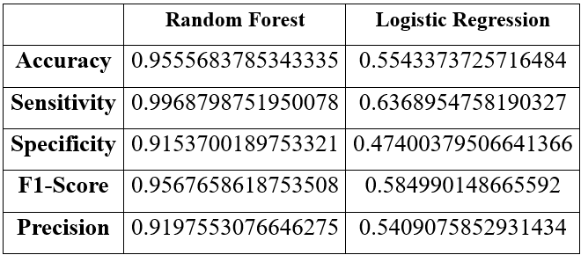
Evaluation
The models evaluated using a range of metrics such as accuracy, precision, recall, and F1-score.
The results were promising, with Sensitivity score 99.6%.
The model captures almost all of the loan applications that should be approved, minimizing the risk of rejecting eligible applications.
Table 1. Metrics Score Between Random Forest vs Logistic Regression

Slide 5
Future Implications
This model can be applied in a system or software to automate and streamline the loan approval process.
This can lead to more efficient decision-making and better risk management for lending institutions.
From the whole process in Flow chart 1, this model will come into play during the "Credit Check" and "Risk Assessment" phases of the loan approval process.

Slide 6
Receive Loan Application
Validate Application
Credit Check
Risk Assessment
Approval Decision
End (Loan Approved)
Flow chart 1. Process of Loan Approval System

Slide 7
Conclusion
This project demonstrates the effectiveness of machine learning in predicting loan default risk. By leveraging data-driven insights, we can make informed decisions that benefit both lenders and borrowers.

Slide 8
Reference
Pino, I. (2024, January 27). How long does it take to be approved for a personal loan? Yahoo! Finance. Retrieved 2024, from https://finance.yahoo.com/personal-finance/how-long-does-it-take-to-get-a-personal-loan-213010800.html.
2. Viswanatha, V., Ramachandra, C. A., Vishwas, N. K., & Adithya, G. (2023). Prediction of Loan Approval in Banks using Machine Learning Approach. International Journal of Engineering and Management Research, 13(4). https://doi.org/10.31033/ijemr.13.4.2

Slide 9
Thank you

Slide 10
Appendix

Slide 11
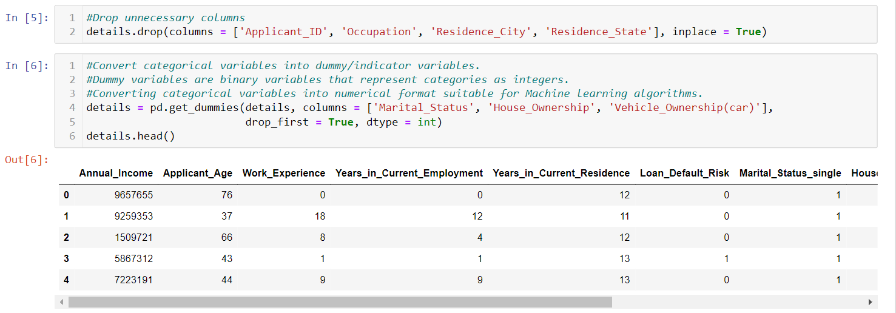
Data Preprocessing Details
1. Dropping unnecessary columns from dataset and convert categorical variables into dummy variable.

Slide 12
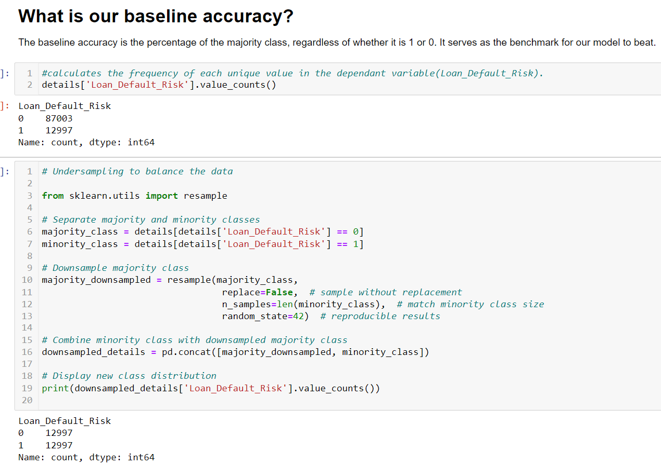
2. Balance the dataset

Slide 13
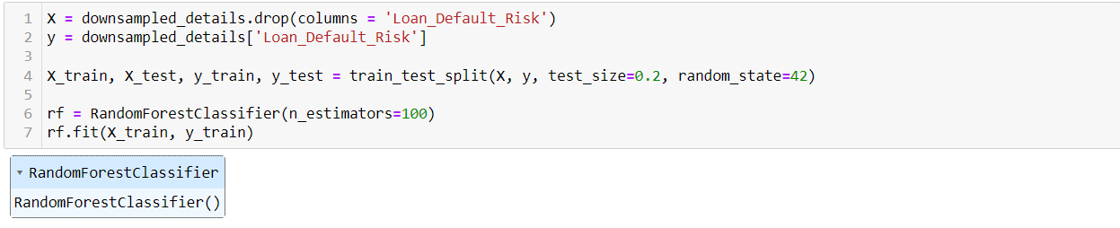
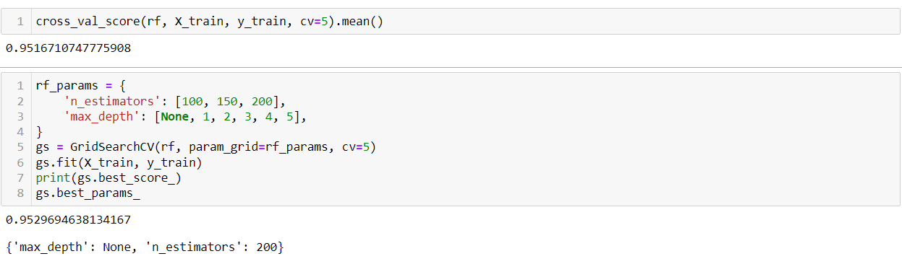
Random Forest Model

Slide 14
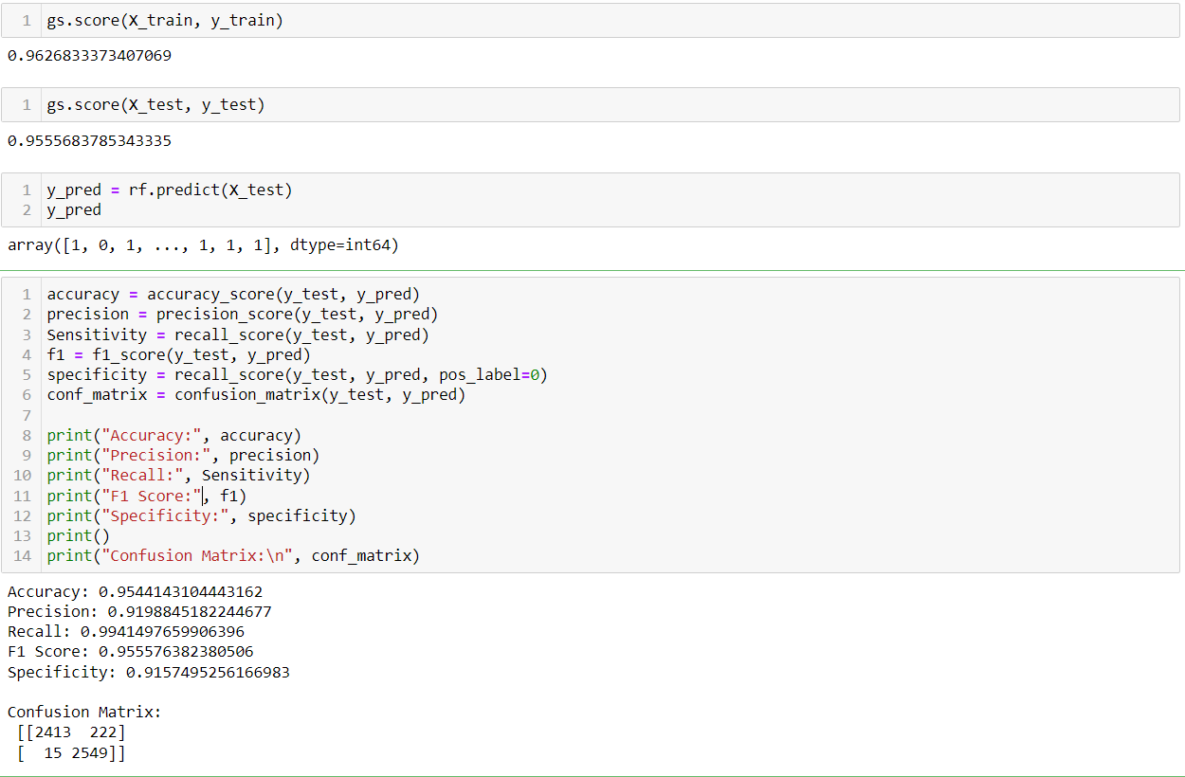

Slide 15
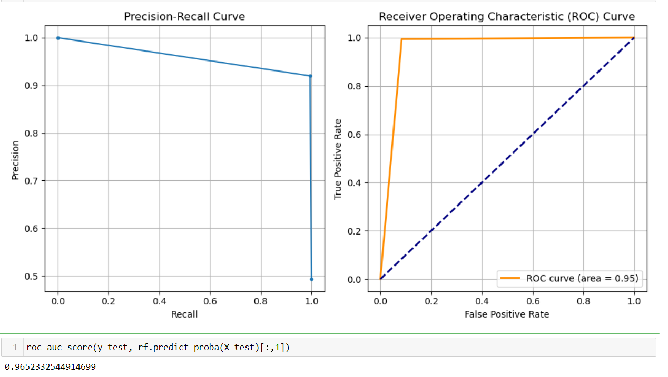

Slide 16
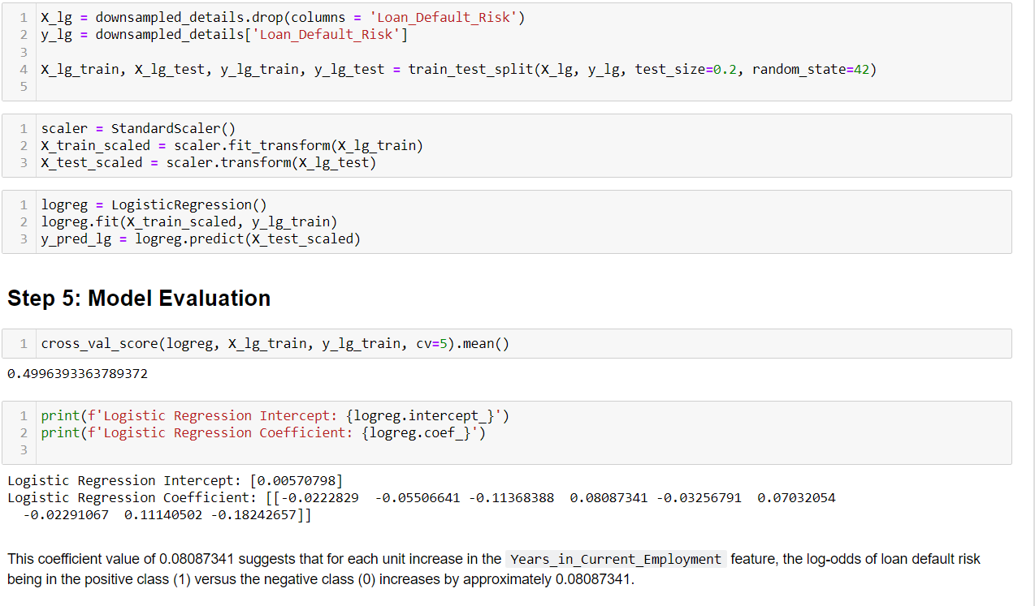
Logistic Regression

Slide 17
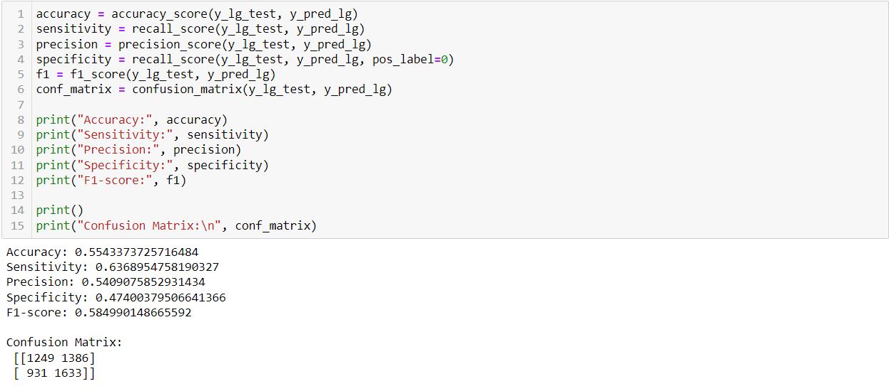

Slide 18
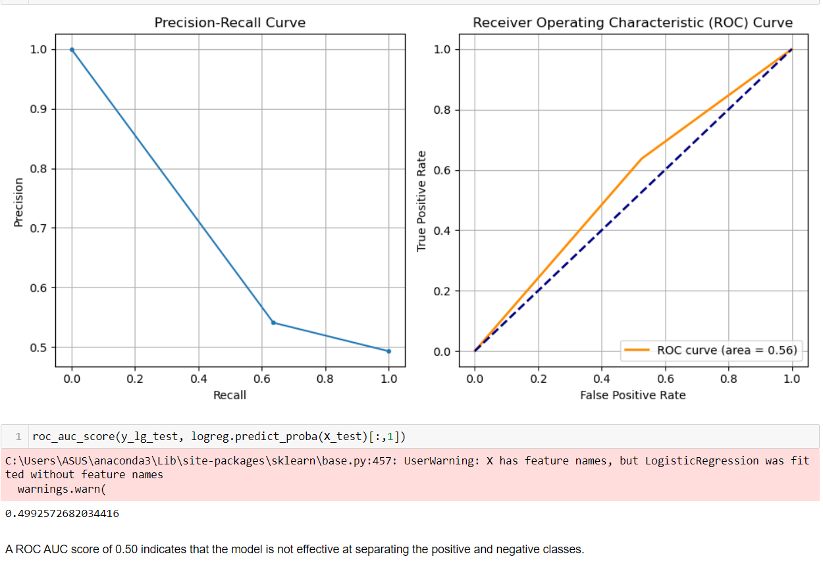

Slide 19
Link to Github
https://github.com/afifadeni/applicant-details-for-loan-approval

